Slide 1

COSI 104a Introduction to machine learning
Chapter 16 – Spectral clustering
 | Instructor: Dr. Hongfu Liu Email: hongfuliu@brandeis.edu
Main source: https://www-users.cs.umn.edu/~kumar001/dmbook/index.php

Slide 2
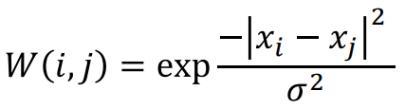
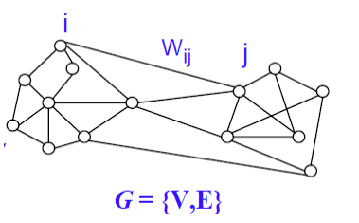
Spectral Clustering
Spectral clustering is a kind of group partition methods.
If your data are not a graph, build a graph
Gaussian graph
K-nearest neighbor graph
b-match graph
Ensemble graph
Graph consists of two sets
Node
Edge

Slide 3
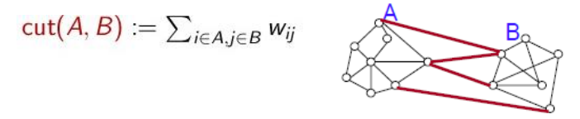
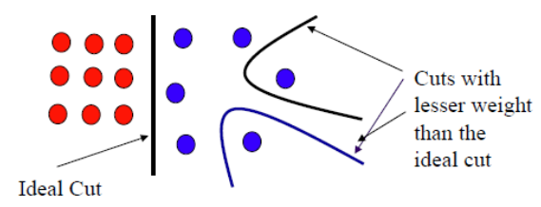
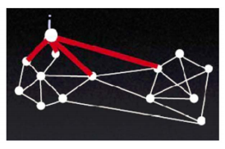
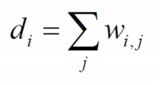
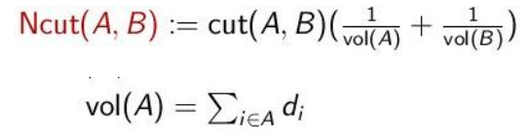
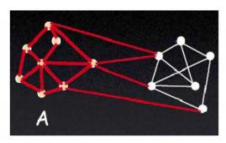

Spectral Clustering (2 clusters)
Min-cut: Partition graph into two sets A and B such that weight of edges connecting vertices in A to vertices in B is minimum.
Things seem NOT right.
Normalized cut: the size of A and B should be similar (when is minimum?)

Slide 4
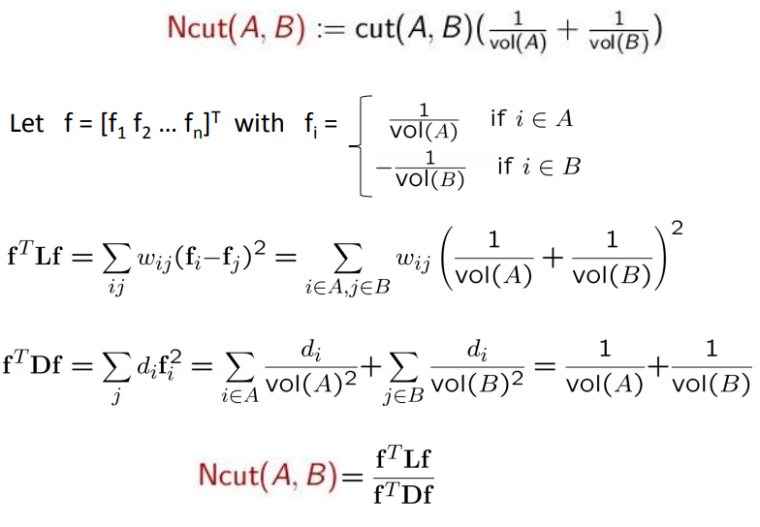

Spectral Clustering

Slide 5
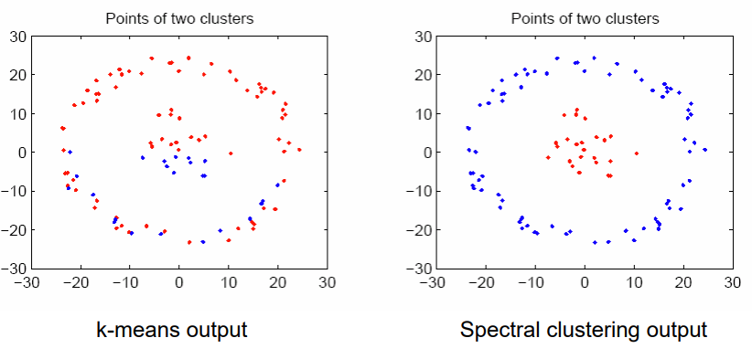
Spectral Clustering
Algorithm
Calculate the proximity matrix L
Build Laplacian matrix I – D^{-1/2}LD^{-1/2}
Obtain k eigen vectors with the least eigen values
Run K-means on k eigen vectors
2-step
Data transformation (embedding)
Record -> graph
Graph -> spectral
Run K-means
Time complexity O(n³)
Space complexity O(n²)

Slide 6

Spectral clustering vs K-means
Spectral clustering, actually is theoretically equal to weighted kernel K-means.
Kernel plays the role in data transformation
Weight can be regarded as the normalization
Two steps merge into one step
kernel K-means with time and space complexity O(n²)
Can we do better?
Too difficult
In some cases, we can
Dhillon, I. S., Guan, Y., & Kulis, B. (2004, August). Kernel k-means: spectral clustering and normalized cuts. In Proceedings of the tenth ACM SIGKDD international conference on Knowledge discovery and data mining (pp. 551-556). ACM.

Slide 7


